Slide 1
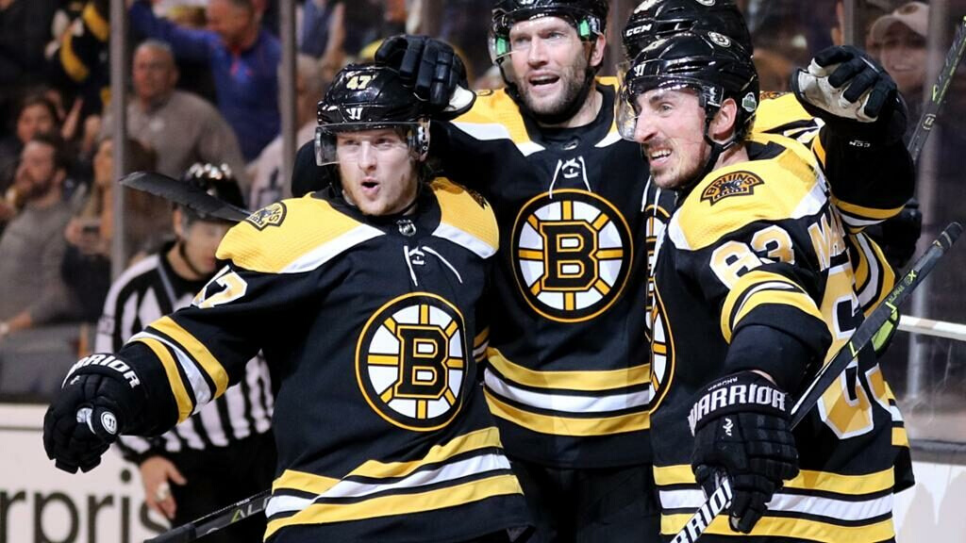


Jenny, Joshua, Ray,
Anshuman, Peng.
Predicting Team & Player Performance

Slide 2
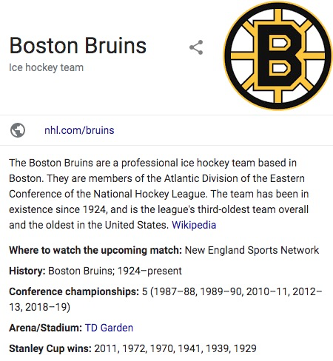
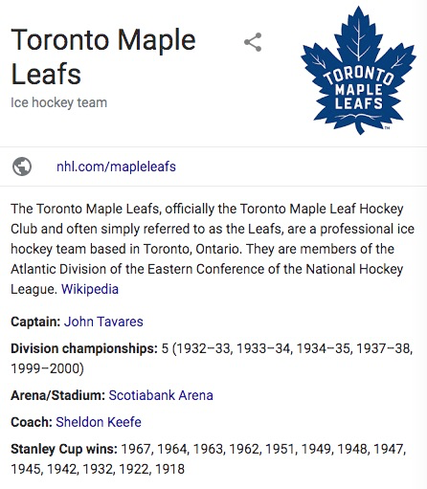
Question 2
Predict Player performance for rest of the season (2019-20)
Evaluate their next contract price
Introduction
2 teams with different salary STRATEGIES.
Methods:
TOI plot
Polar map
PACF
Non-linearity check
Model compare

Slide 3
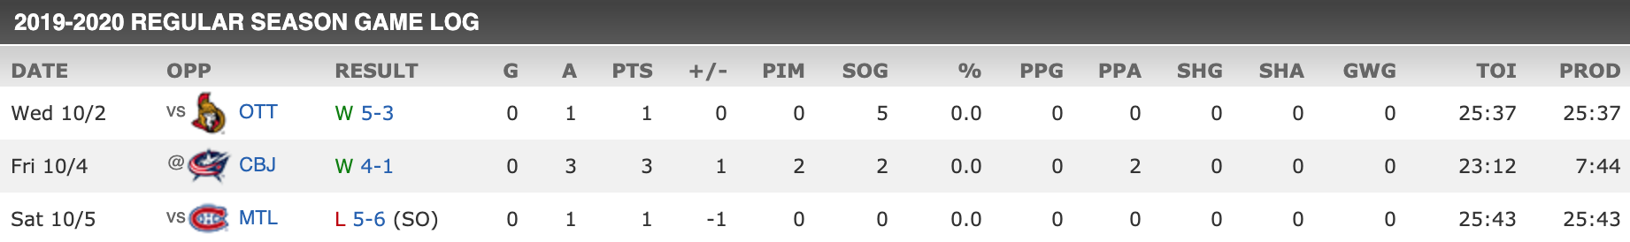

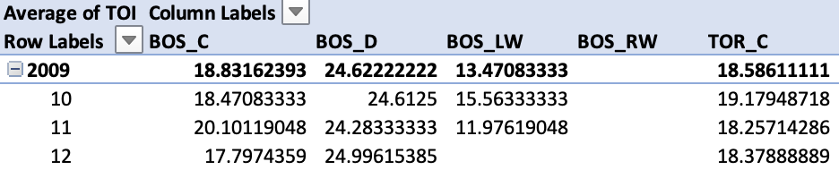

Game Log
Calculate the monthly average of TOI
Fill out missing by the average TOI of last 4 months
Removed the season 2012-2013 with just four month
The 2012–13 NHL season was the 96th season of operation (95th season of play) of the National Hockey League (NHL). The regular season began on January 19, 2013 and ended on April 28, 2013, with the playoffs to follow until June. The season start was delayed from its original October 11, 2012 date due to a lockout imposed by the NHL franchise owners after the expiration of the league's collective bargaining agreement (CBA).
DATA PREPROSSESING
How we deal with our data?
Data Cleaning
data preprocessing
Problem
null columns
lack seasonal recording

Slide 4
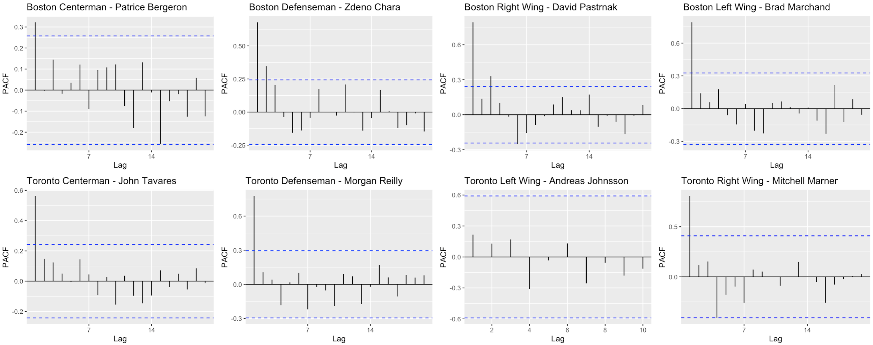

PACF plot analysis
Strong relationship between the performance in neighboring months
Significant lags are all at 1
Not enough data for new player to show relationships

Slide 5

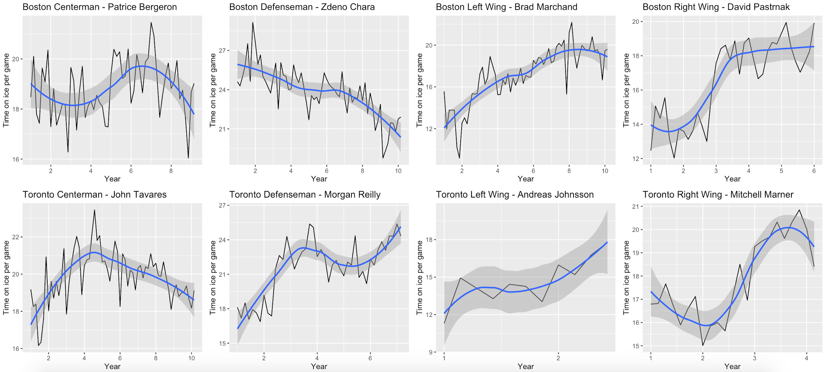
What is Time on Ice - TOI?
Ps: defenceman on the top two pairings will generally log the most amount of time on ice usually around 20+ min while the top forwards on the team will log around 17-21 min per game.
Measures
Total amount of time a player is on the ice during the playing of the game
Indicator
Thow a coach views the player and their contribution with more time going to players considered to be producers either through point production or point prevention
Notes:
A statistic in hockey that measures the total amount of time a player is on the ice during the playing of the game. Time on Ice is a decent indicator of how a coach views the player and their contribution with more time going to players considered to be producers either through point production or point prevention.

Slide 6
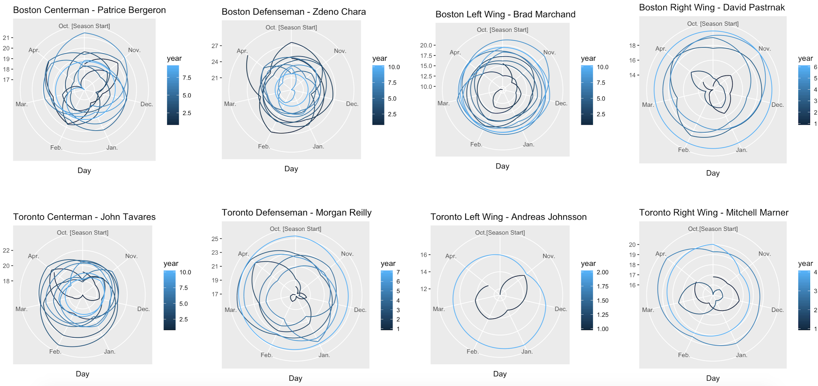
Seasonality Analysis
seasonality is the presence of variations that occur at specific regular intervals less than a year, such as weekly, monthly.
we could see:
which month has better performance
seasonal performance stationality
Polar map of the performance of 4 players in Boston Bruins and Toronto Maples

Slide 7
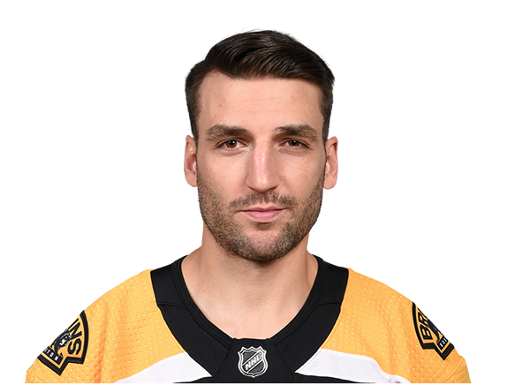




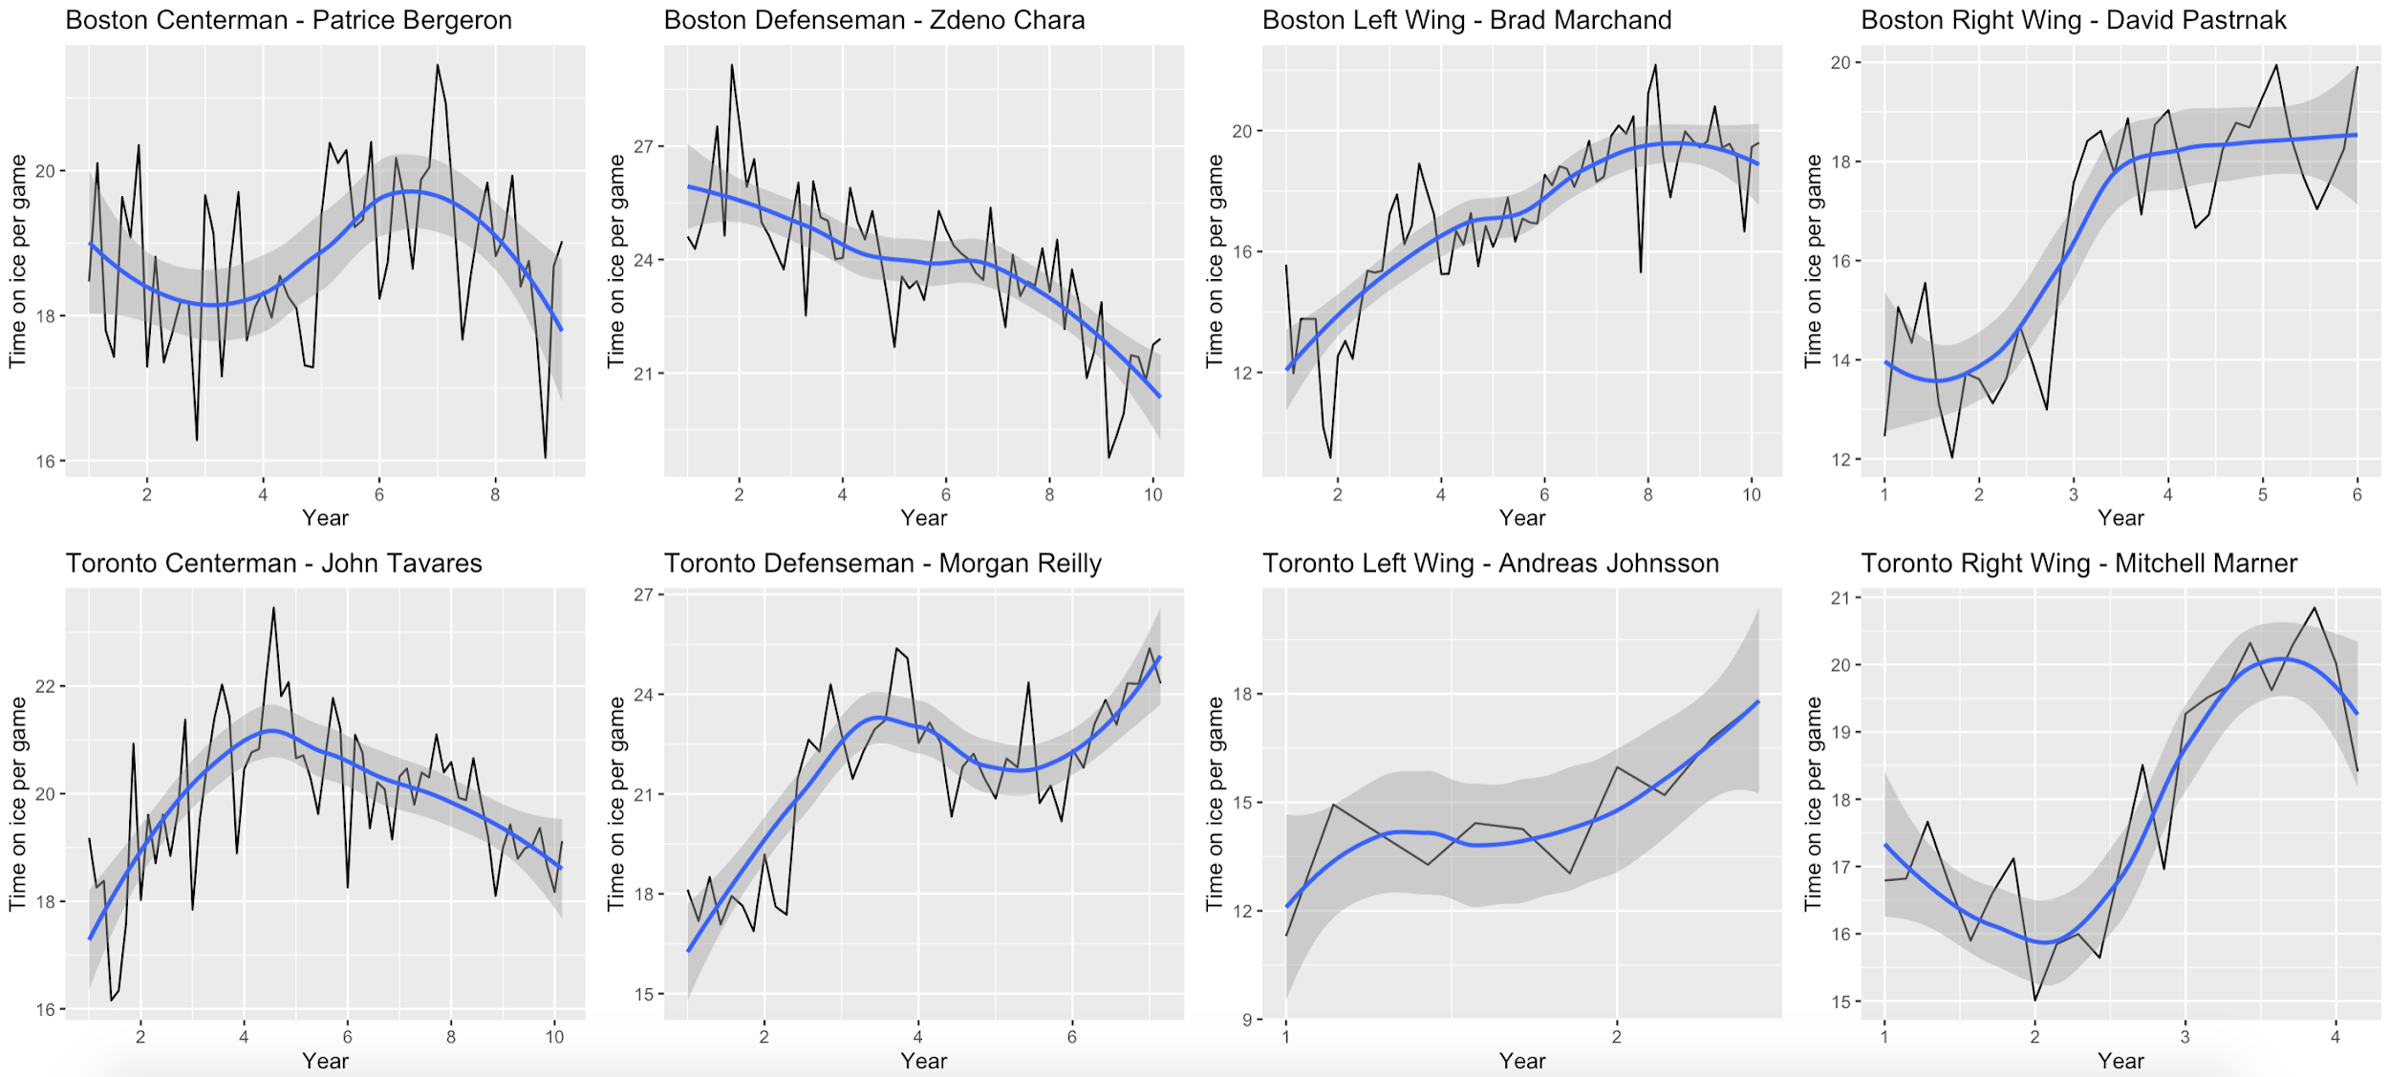
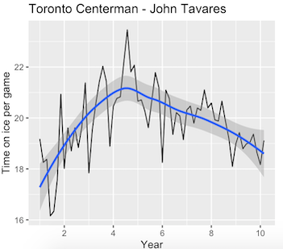
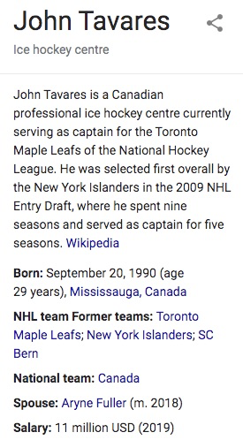
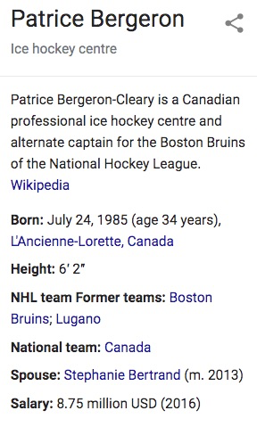
18 ~ 20 min per game
Estimated time on ice
16 ~ 22 min per game
Estimated time on ice
stable
Peak
fluctuate behaviour in seasons
better at season beginning
more stable in seasons performance
better during middle season(April)

Slide 8
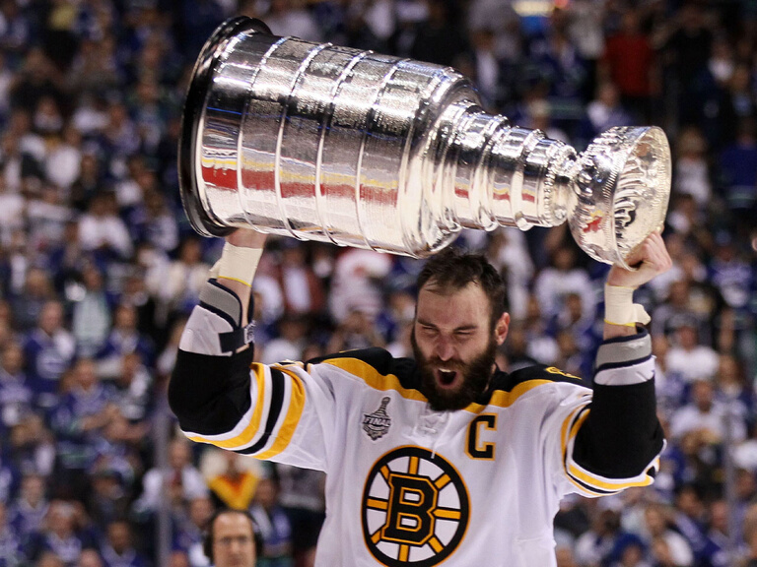
Modeling
Tests of Non-linearity
P-Value of most tests >0.05, "indicating a non-linear model is not necessary"
Transformation
Box- Cox method
We applied the argument lambda="auto" to each model
Testing Set
1-year observations taken for original time series

Slide 9


Boston Centerman - Patrice Bergeron passed 5/6 tests
Boston Defenseman - Zdeno Chara
passed 4/6 tests
Toronto Centerman - John Tavares passed 4/6 tests
Toronto Defenseman - Morgan Reilly passed 3/6 tests
Tests of Non-linearity
Overview

Slide 10
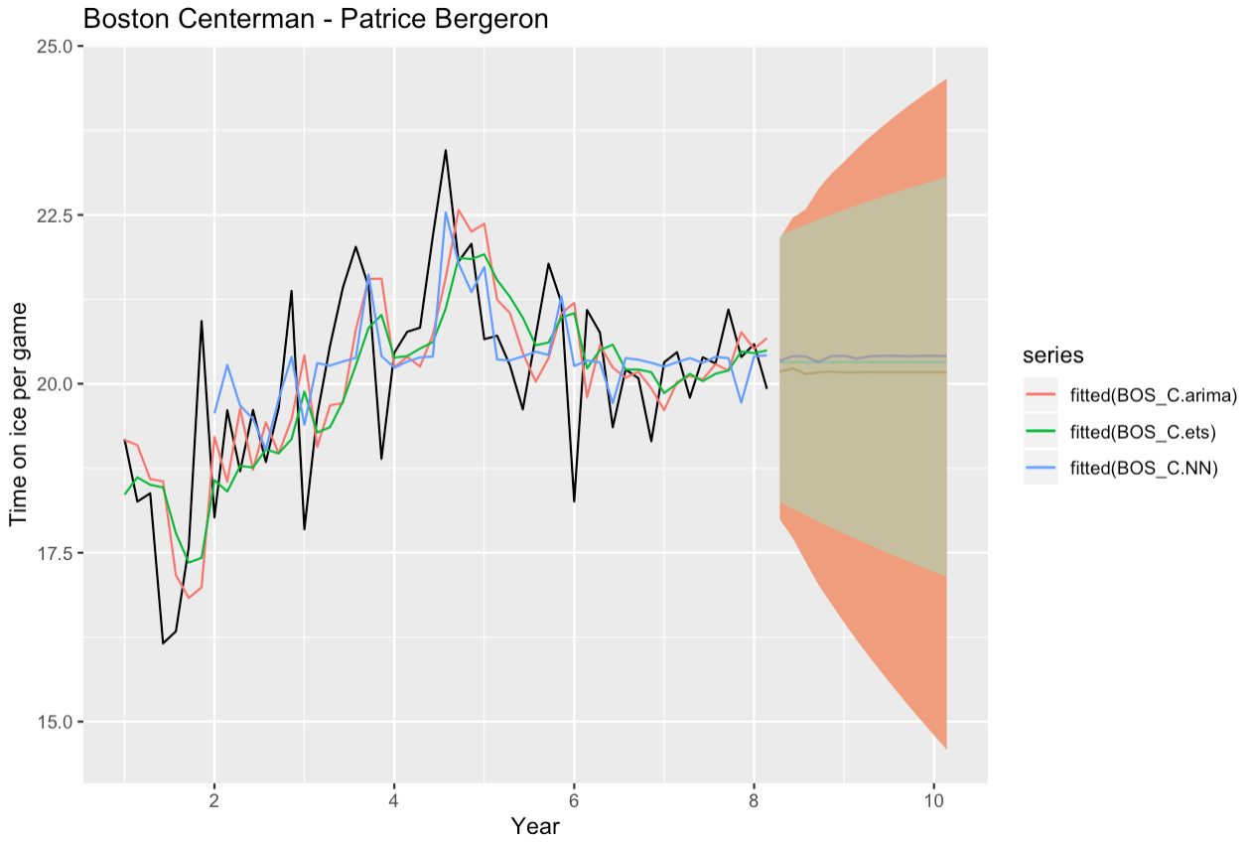
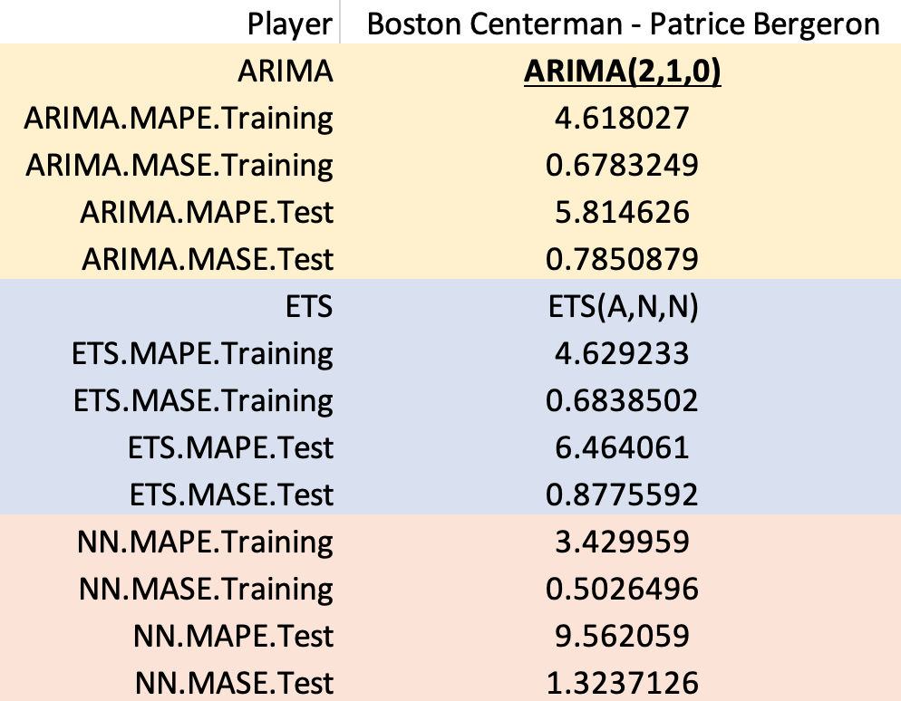
18 ~ 20 min per game
Estimated time on ice
PERFORMANCE FORECAST
KEEP the same contract!

Slide 11

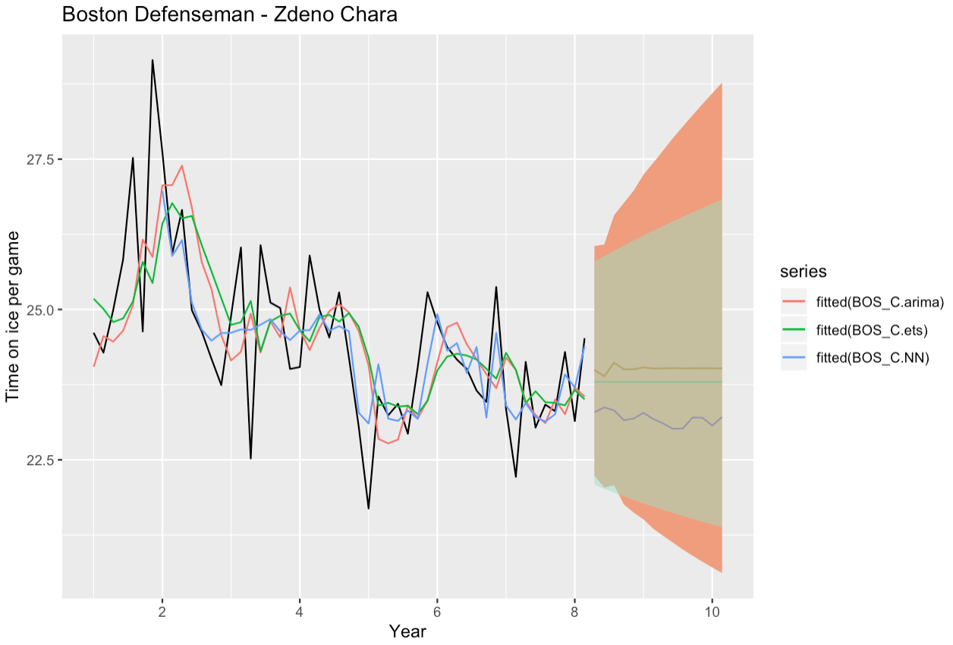
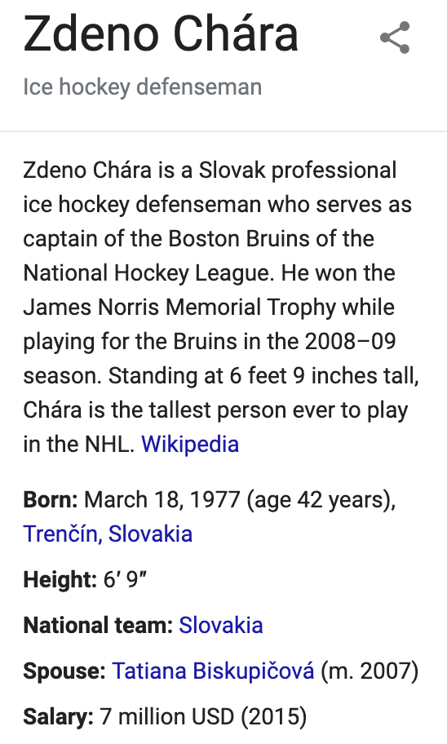
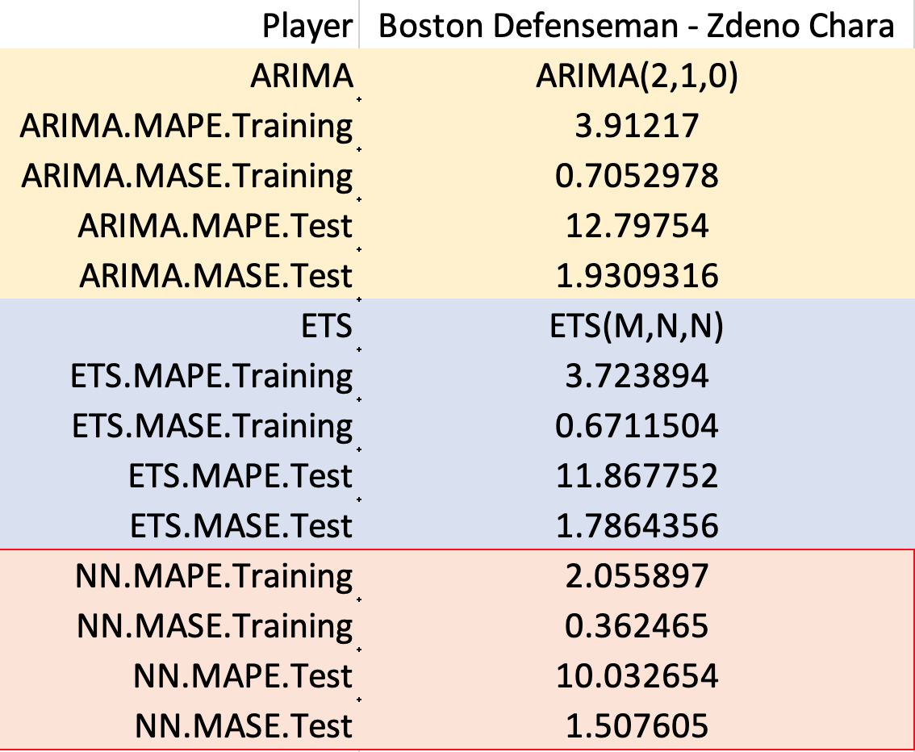
22 ~ 24 min per game
Estimated time on ice
PERFORMANCE FORECAST
REDUCE contract amount!

Slide 12
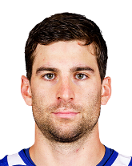

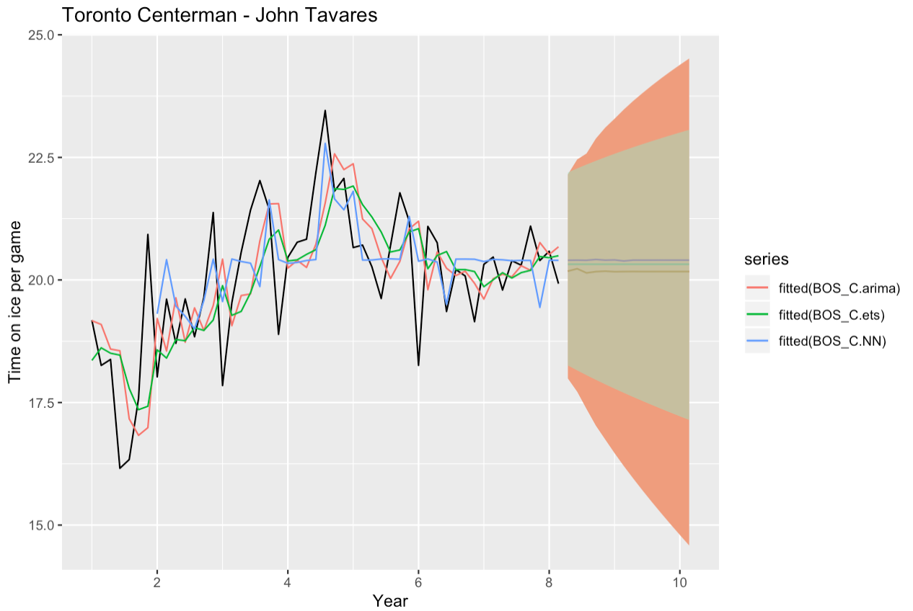
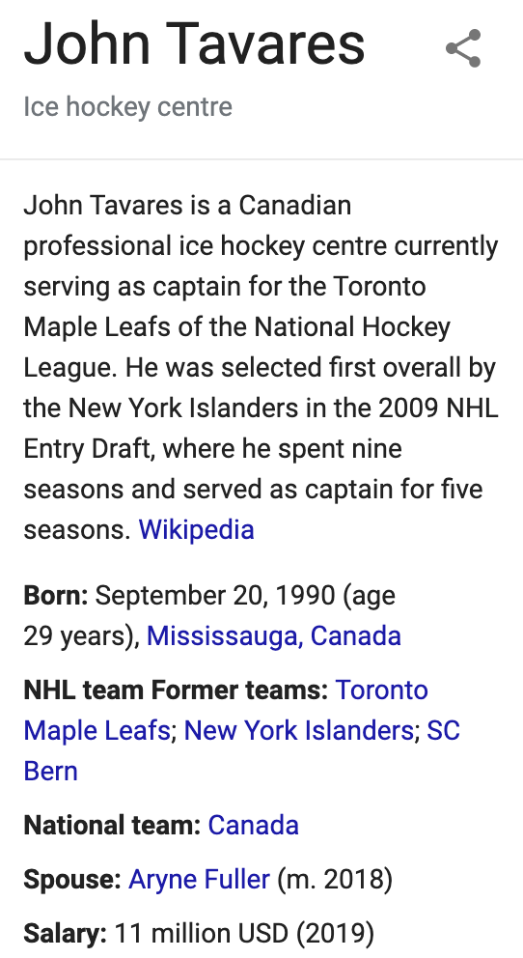
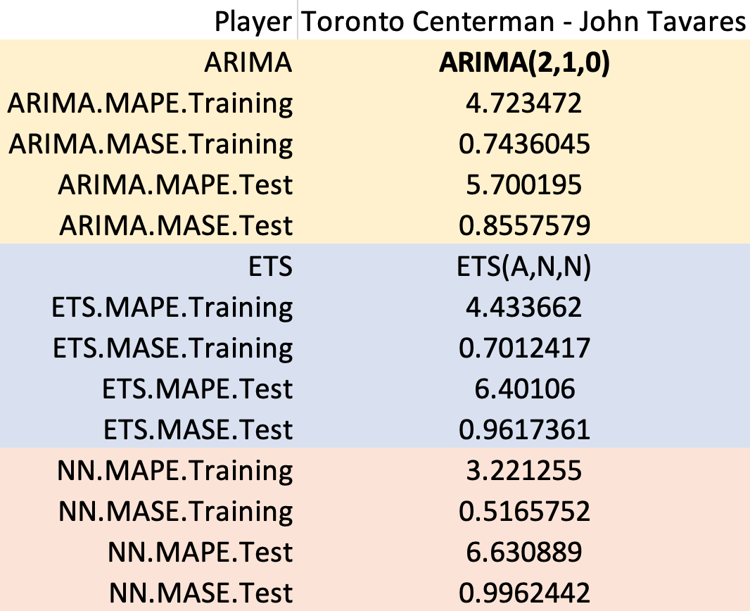
19 ~ 21 min per game
Estimated time on ice
PERFORMANCE FORECAST
KEEP the same contract!

Slide 13
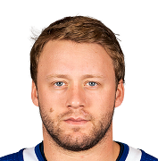
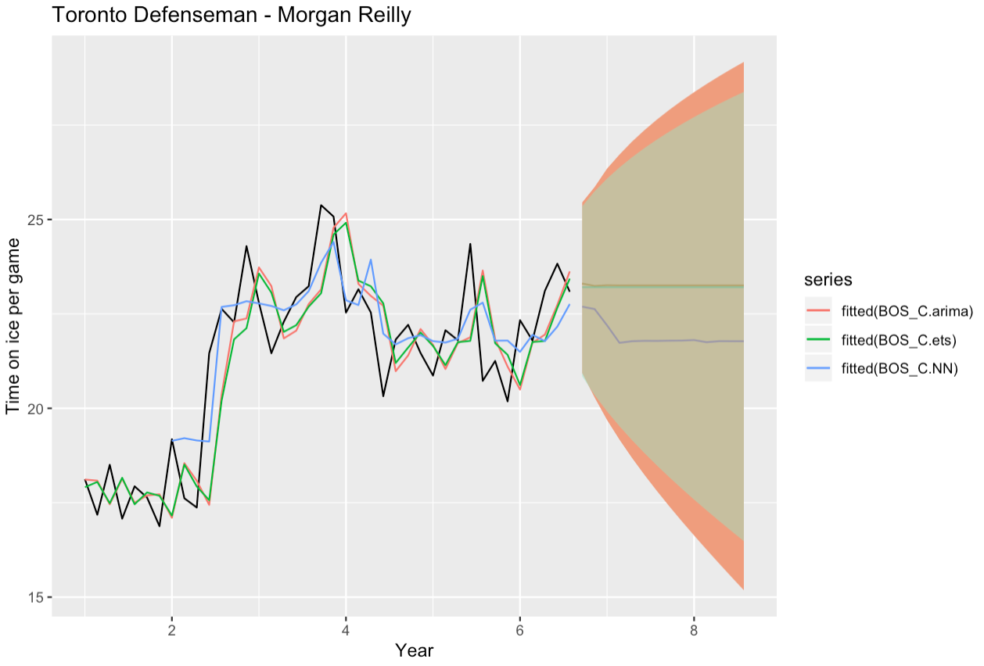
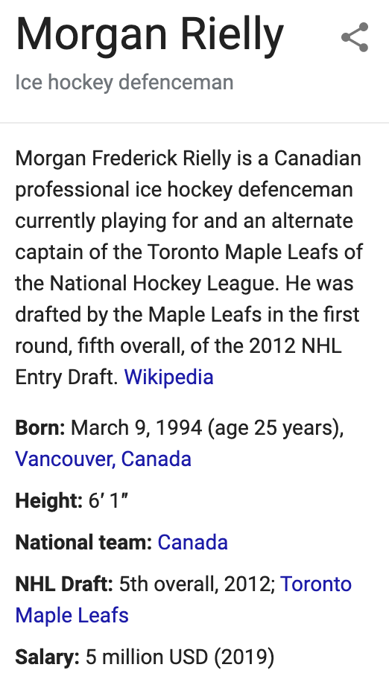
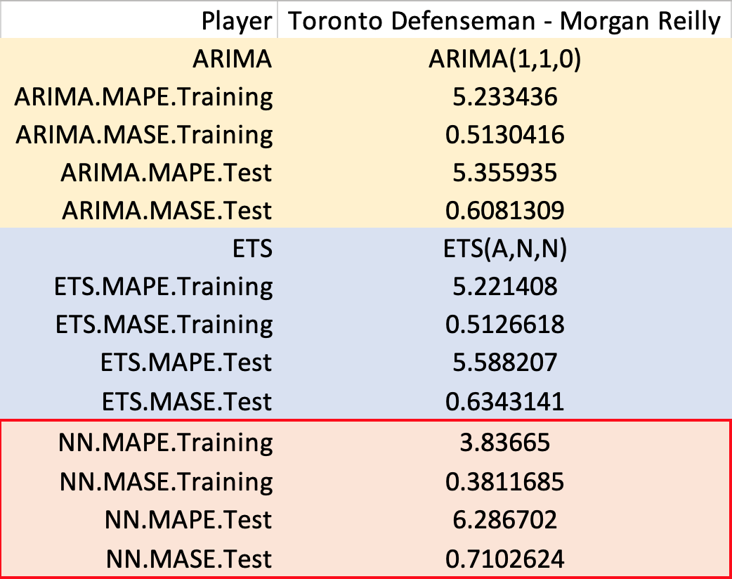
20 ~ 23 min per game
Estimated time on ice
PERFORMANCE FORECAST
KEEP the same contract!

Slide 14
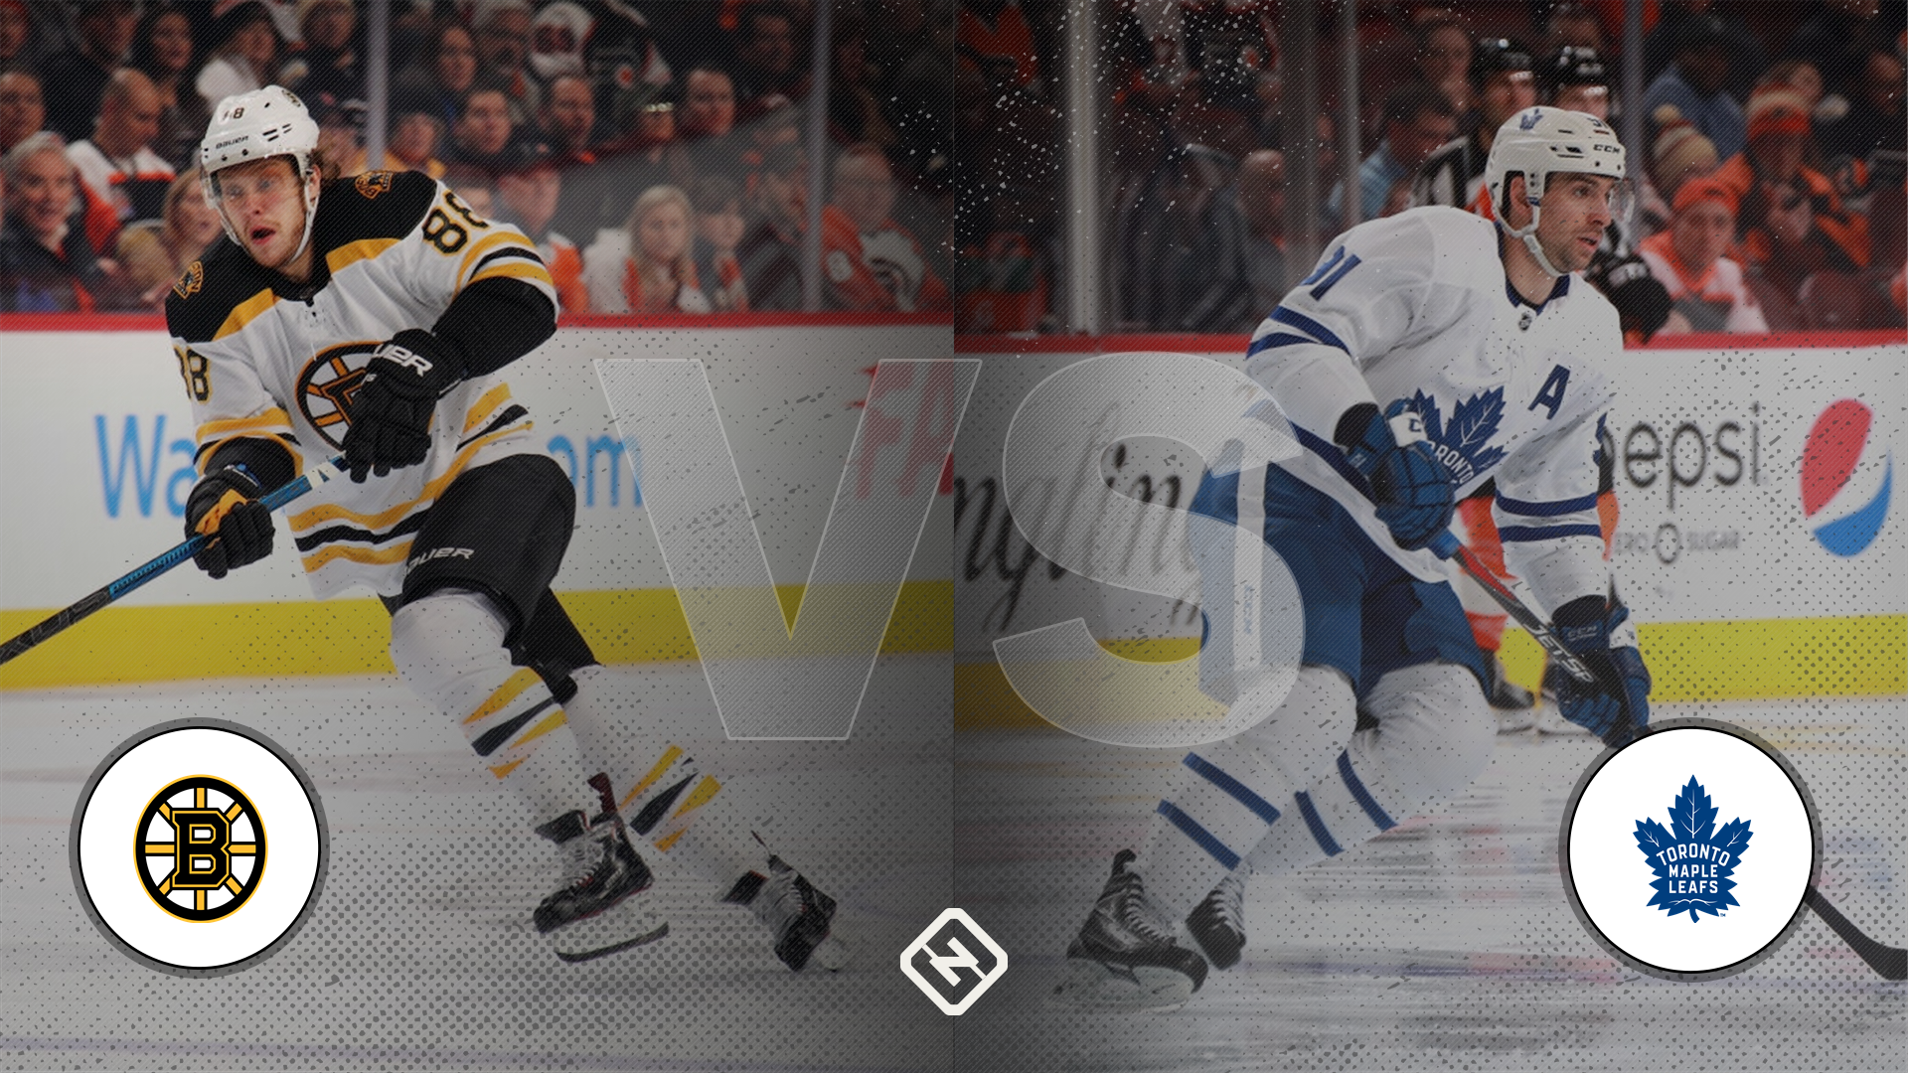
Q & A

